Slide 1

Guidelines and Standards + Mantid
Anders Markvardsen
STFC
April 2016, SINE2020, PSI

Slide 2
Outline
Task 10.2: Guidelines and Standards
More broadly tasks 10.2-4 and Mantid
Visualisation
Fitting
Interoperability

Slide 3
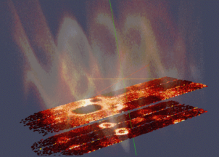
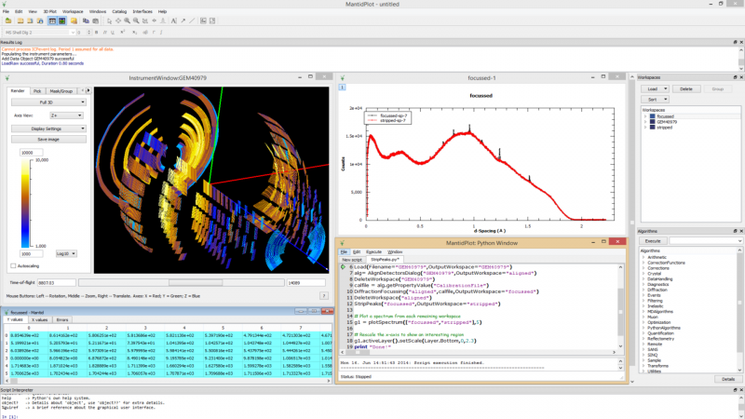
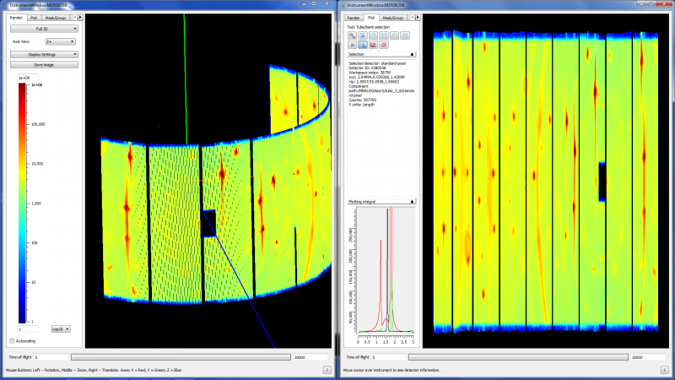



The Mantid Project
In one slide Mantid
Aims
Data reduction/analysis framework for neutron scattering and muon experiments
Cross-platform
Easily extensible
Freely redistributable
Open source
Adoption
3(4) Partner Facilities
9(8) Contributing Organisation
In use on 52 instruments worldwide
Notes:
So Neutron scattering is very powerful, but without software to help understand the results of these large instruments they are worthless

Slide 4
Guidelines and Standards
Task 10.2 of this WP
Due date 1st April 2017
Coordinator: STFC
Partners: ESS, FZJ, PSI
Observers: ILL

Slide 5
Previous work to task 10.2
2014: NMI3-II Data Analysis Standards (WP6) Task 2: solutions for developing a common software infrastructure
2011: PaN-data (D2.2) Common policy framework on analysis software

Slide 6
Sentences from Task 10.2
Guidelines and standards will be established that enable different software components to be linked together in an interoperable (plug and play) manner
Particular emphasis will be put on pluggable fitting functions, including Bayesian fitting

Slide 7
‘Low’ level interoperability
Algorithm Dialogs Custom Interfaces Custom Menus
Algorithms
Unit Conversions
Fit Functions Cost Models Constraints Minimizer
Workspaces
Archive Searching LiveData Listeners Data Catalogs
GUI
Framework
(Framework) Utility

Slide 8
Pluggable fitting functions
SasView
BornAgain
Mantid
Other?

Slide 9
Pluggable fitting functions - Mantid
Fit
<<use>>
<<use>>
<<use>>
<<use>>
IFunction
ICostFunction
IConstraint
IFuncMinimizer
CompositeFunction
PolynomialBackground
BackToBackExponentialPV

Slide 10
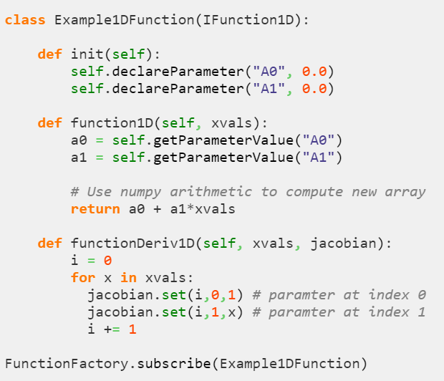
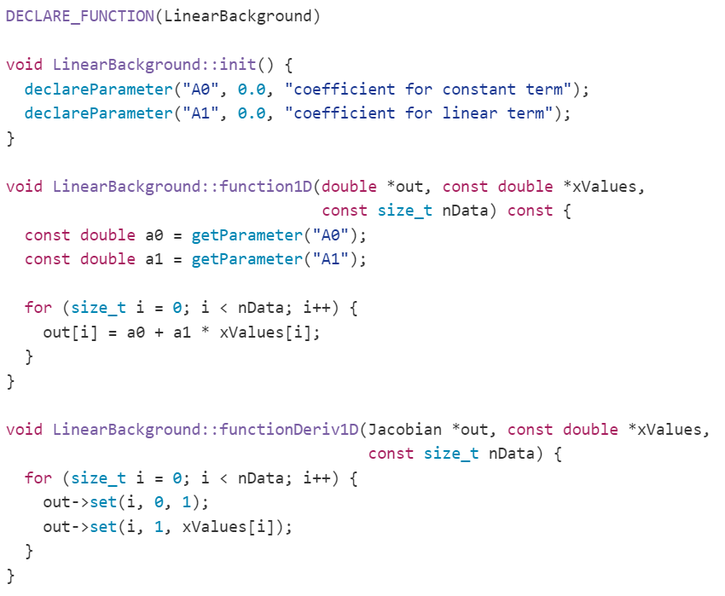
Pluggable fitting functions - Mantid
Fit Function in Python
Same Fit Function in Python

Slide 11
Bayesian fitting
Fit
<<use>>
<<use>>
<<use>>
<<use>>
IFunction
ICostFunction
IConstraint
IFuncMinimizer
FABADA

Slide 12
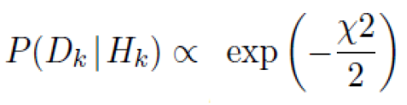
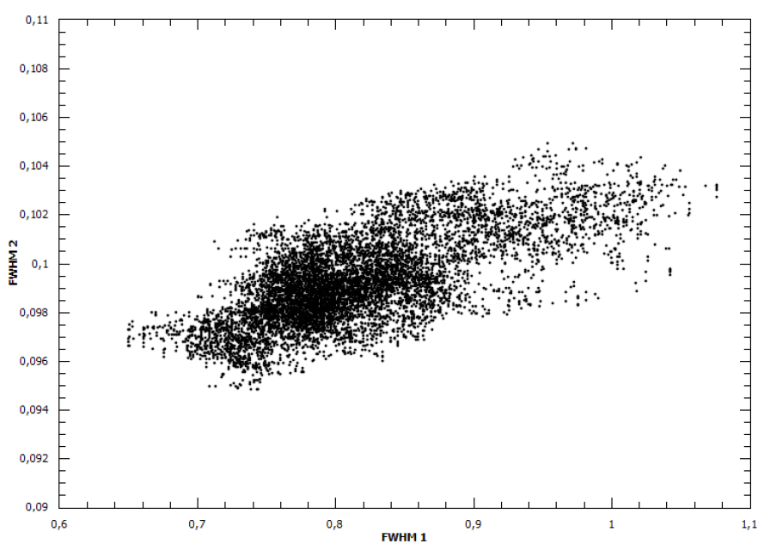
Bayesian fitting: FABADA
Fitting Algorithm for Bayesian Analysis of DAta

Slide 13
Guidelines & standard for testing fit minimizers
How do you know if one minimizer is better than another for a certain class of neutron facility fitting problems?
First demonstration of this is expected by June 2016 (Mantid 3.7)

Slide 14
‘High’ level interoperability
E.g. SasView/GSAS/McStas/nMoldyn/ASE… linking with Mantid
Send-to option

Slide 15
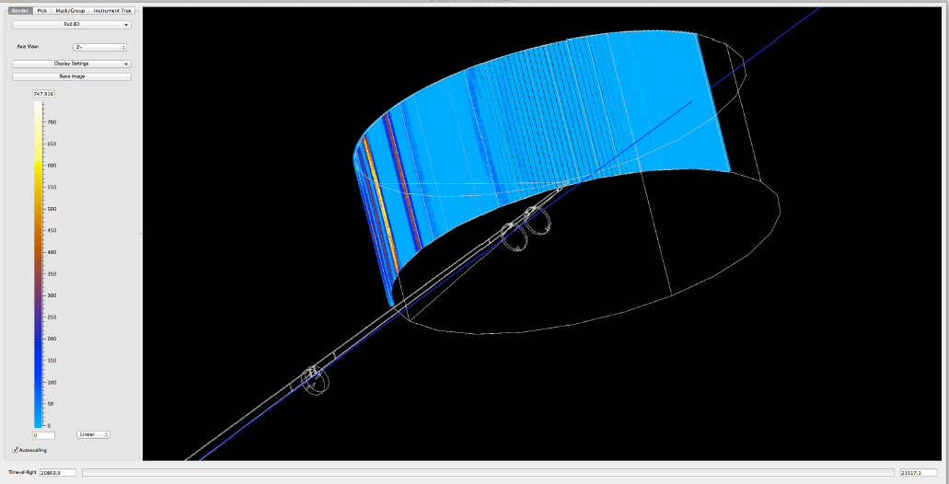
‘High’ level interoperability – McStas/Mantid
LoadMcStas algorithm

Slide 16
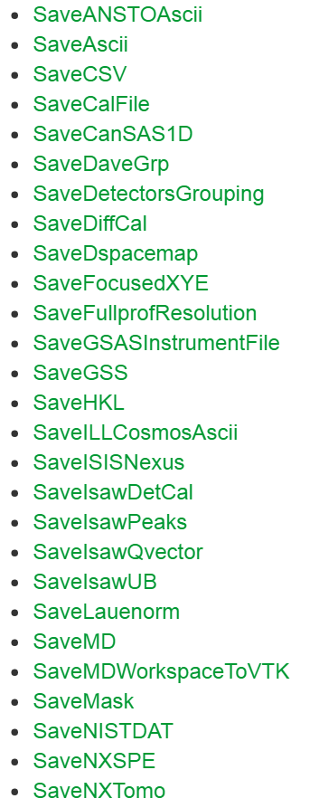
‘High’ level interoperability – GSAS/Mantid

Slide 17
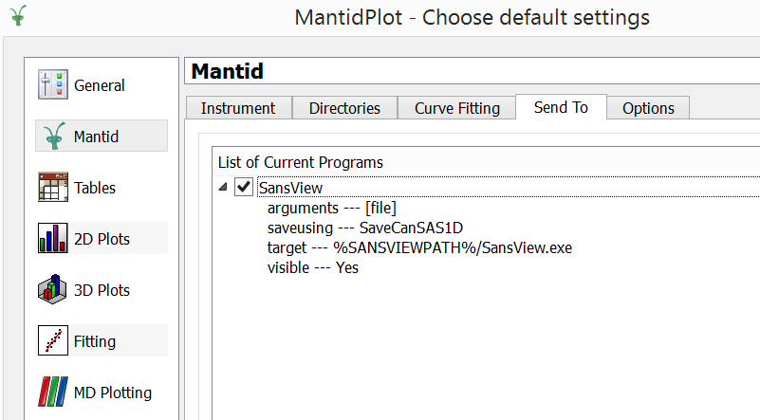
‘High’ level interoperability – Send-to option

Slide 18
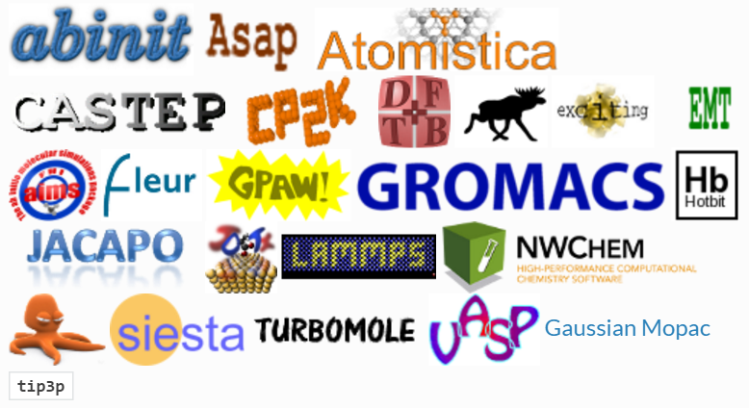
‘High-high’ level interoperability – ASE
Atomic Simulation Environment
http://www.mantidproject.org/ASE

Slide 19
Further sentences from Task 10.2
Guidelines and Standards will be provided for application programming interfaces (API), command line interfaces (CLI), graphical user interfaces (GUI), data formats as well as software development environments

Slide 20
Application Programming Interface (API)
Command line interfaces (CLI) – Python
Graphical user interfaces (GUI) – Qt, reusable widgets, PyQt
Data formats - NeXus

Slide 21
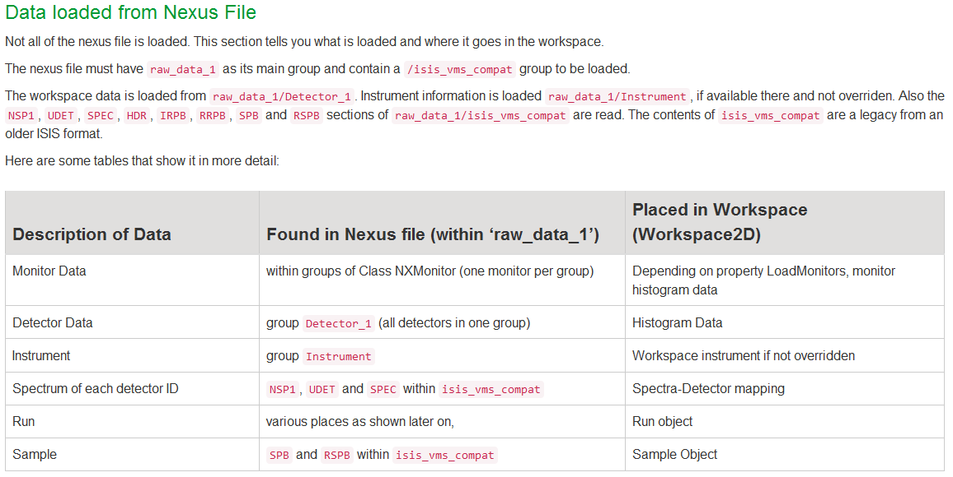
Standard for documenting data loaders

Slide 22
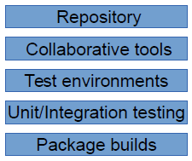
Software development environments
NMI3-II
2014
Now
(Mantid)
Git/SVN
Facility based
E.g. Trac
Redmine
Jenkins
Yes please
Cross-platform
Git
Cloud based
Github
Jenkins
Yes please
Cross-platform (CPACK)

Slide 23




Software development - Mantid
Continuous build and testing
20+ build servers managed through Jenkins
Static code analysis
Over 8,500 automated unit tests
Almost 300 automated system tests
Comprehensive documentation
Including 675 automated tests on included scripts
Both online and installed with Mantid

Slide 24
STFC contributing broader: Tasks 10.2-4
Visualisation
Fitting
Interoperability of software

Slide 25
Challenges facing MD visualisation
Visualize massive data sets in n-dimensions
Efficiently handle sparse as well as dense n-dimensional data
Operate on such data very quickly
Usability / customisability for different techniques
Simulation and fitting

Slide 26
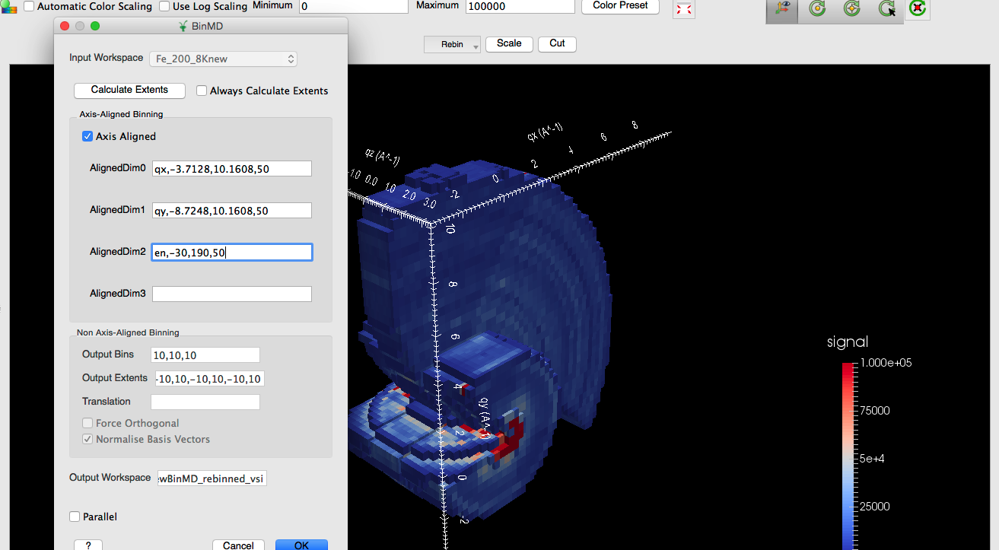
In-situ rebinning

Slide 27
YFeO3 magnetic scattering

Slide 28
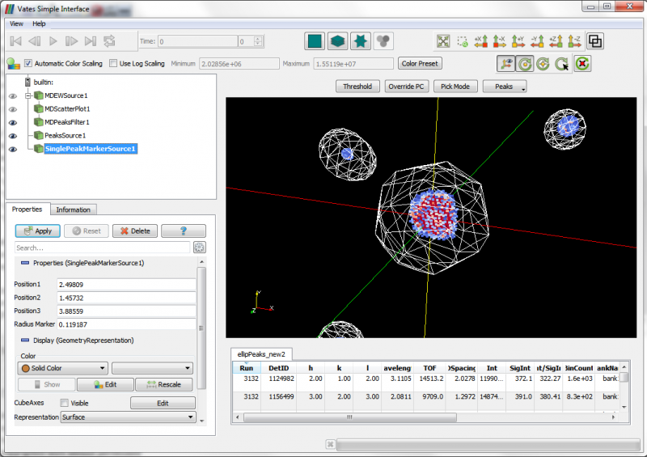
Inspecting peak integration

Slide 29
Challenges facing fitting
Usability
Some documentation aspects missing
Fitting large number of datasets simultaneously
Better minimizers

Slide 30
Interoperability project planned
DFT codes
Site Information
Spin Density
Quantum/Dipole Field subroutine libraries
Visualisation Tools
Neutrons
Simulated Spectra
Data Fitting
Explore candidate muon site,
Spin density, etc
Mantid

Slide 31
Challenges with Mantid imaging
September: first IMAT user
Filters for pre and post processing
Wavelength dependent reconstructions
3D visualisation

Slide 32

Future Mantid Tasks
Multiple Scattering Corrections
Better integration with Third Party simulation codes
VASP, Gaussian, CASTEP, McPhase, SpinW/Spinwavegenie etc
Common Language - ASE
Better use of facility / cloud resources
- Remote desktop – Performance and stability
- Client server Mantid
- Web based UI
- Parallel visualisation rendering

Slide 33
Discussion items
Standard for a fit function format?
Bayesian fitting guidelines and/or interoperability library?
Better send-to options
Any comments to standard for documenting data loaders
Visualisation
Discuss other interoperability projects
Any other?

